Slide 1
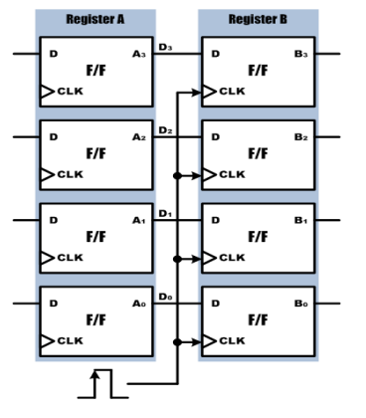
데이터의 저장과 전송

Slide 2
데이터의 저장과 전송
module registertrans(
input DATA_IN, CLK1, CLK2,
output reg [3:0] A, B
);
always @(posedge CLK1)
begin
A <= DATA_IN;
end
always @(posedge CLK2)
begin
B <= A;
end
endmodule

Slide 3
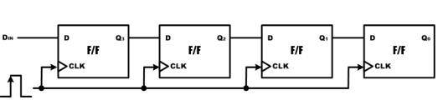
4bit 쉬프트 레지스터

Slide 4
4bit shiftregister
module shift4(
input RESETN, DATA_IN, CLK,
output reg [3:0] Q );
always @(posedge RESETN or posedge CLK)
begin
if (RESETN == 1'b1)
Q <= 4'b0000;
else
begin
Q[2:0] <= Q[3:1];
Q[3] <= DATA_IN;
end
end
endmodule

Slide 5
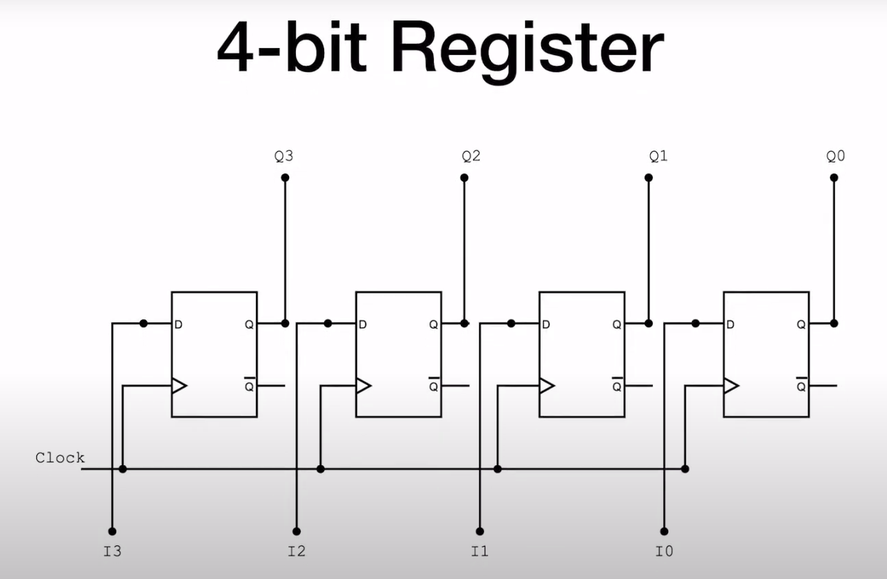
병렬입력 병렬출력 레지스터

Slide 6
module simple_register
#(parameter N= 4) (
input clk.
input [N-1: 0] I,
output [N-1: 0] Q
);
reg [N-1:0] Q_reg, Q_next;
always@(poosedge clk)
begin
Q_reg <= Q_next;
end
always@(I)
begin
Q_next = I ;
end
assign Q = Q_reg ;
endmodule

Slide 7
4bit 병렬입력 병렬출력
module pipo(
input CLK, CLRN,
input [3:0] D,
output reg [3:0] Q
);
always @(posedge CLRN or posedge CLK)
begin
if (CLRN)
Q <= 4'b0000;
else
Q <= D;
end
endmodule

Slide 8
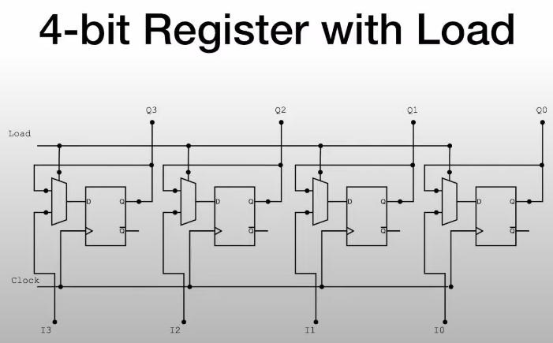

Slide 9
module register4withload
#(parameter N= 4) (
input load,
input clk.
input [N-1: 0] I,
output [N-1: 0] Q
);
reg [N-1:0] Q_reg, Q_next ;
always@(poosedge clk)
begin
Q_reg <= Q_next;
end
always@(I, load)
begin
if(load)
Q_next = I ;
else
Q_next = Q_reg ;
end
assign Q = Q_reg ;
endmodule

Slide 10
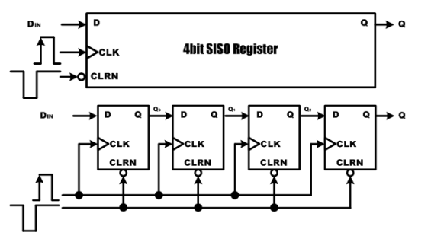
직렬입력 직렬출력 레지스터

Slide 11
직렬입력직렬출력
module siso(
input CLK, CLRN,
output DIN, Q
);
reg [3:0] BUFF;
always @(negedge CLRN or posedge CLK)
begin
if (CLRN == 1'b0) BUFF = 4'b0000;
else
begin
BUFF[3:1] = BUFF[2:0];
BUFF[0] = DIN;
end
end
assign Q = BUFF[3] ;
endmodule

Slide 12
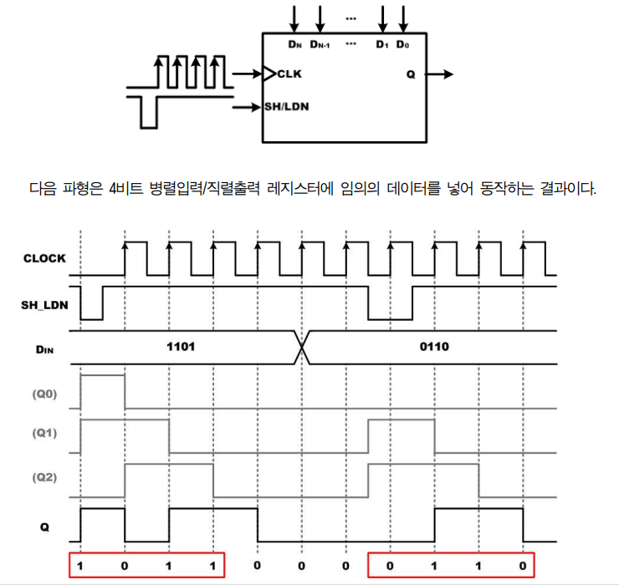
병렬입력 직렬출력 레지스터

Slide 13
병렬입력직렬출력
module piso4(CLK, SH_LDN,D, Q);
input CLK, SH_LDN;
input [3:0] D;
output Q;reg [3:0] BUFF;
wire Q;
always @(negedge SH_LDN or posedge CLK)begin
if (~SH_LDN)BUFF = D;
else
begin BUFF[3:1] = BUFF[2:0];BUFF[0] = 1'b0;
end
end
assign Q = BUFF[3];
endmodule

Slide 14
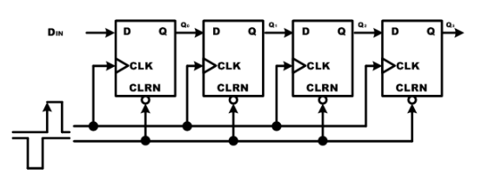
직렬입력 병렬출력 레지스터

Slide 15
module sipo(
input CLK, RESETN,
input DATA_IN,
output reg [3:0] Q
);
always @( negedge RESETN or posedge CLK)
begin
if (RESETN)
Q = 4'b0000;
else
begin
Q[2:0] = Q[3:1];
Q[3] = DATA_IN;
end
end
endmodule

Slide 16
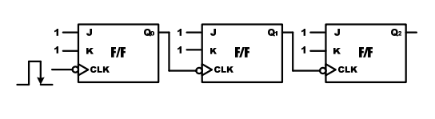
비동기식 카운터

Slide 17
비동기식 카운터
module asyncount (
input CLK,
output reg [2:0] Q );
always @(negedge CLK) begin
if (Q[0] == 1'b0 )
Q[0] = 1'b1;
else
Q[0] = 1'b0;
end
always @(negedge Q[0]) begin
if (Q[1] == 1'b0 )
Q[1] = 1'b1;
else
Q[1] = 1'b0;
end
always @(negedge Q[1]) begin
if (Q[2] == 1'b0 )
Q[2] = 1'b1;
else
Q[2] = 1'b0;
end
endmodule

Slide 18
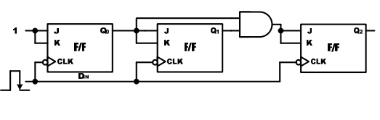
동기식 카운터

Slide 19
동기식카운터
module synccount(
input RESETN, CLK,
output reg [2:0] Q
);
always @(posedge RESETN or negedge CLK)
begin
if (RESETN) Q = 3'b000;
else if (Q >= 3'b111 ) Q = 3'b000;
else Q = Q + 1;
end
endmodule

Slide 20
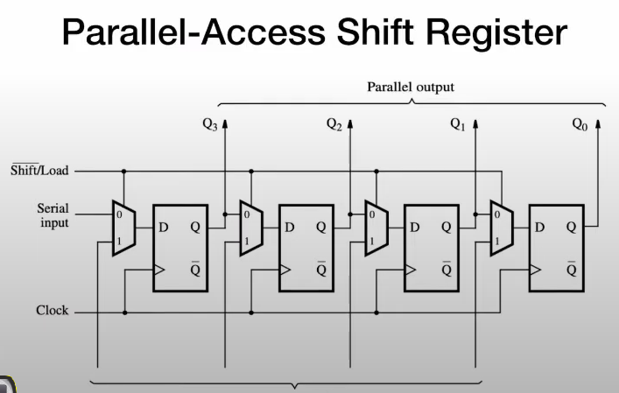

Slide 21
module paralaccess_register
#(parameter N= 4) (
input clk. input SI, input [N-1:0] I, input load, input reset_n, output [N-1:0] Q,
output SO
);
reg [N-1:0] Q_reg, Q_next ;
always@(poosedge clk, negedge reset_n)begin
if(!reset_n) Q_reg <= 1’b0 ;
else Q_reg <= Q_next ;
end
always@(SI , Q_reg)
begin
if(load) Q_next = I ;
else Q_next = {SI, O_reg[N-1:1]};
assign SO = Q_reg[0] ;
assign Q = Q_reg ;
endmodule

Slide 22
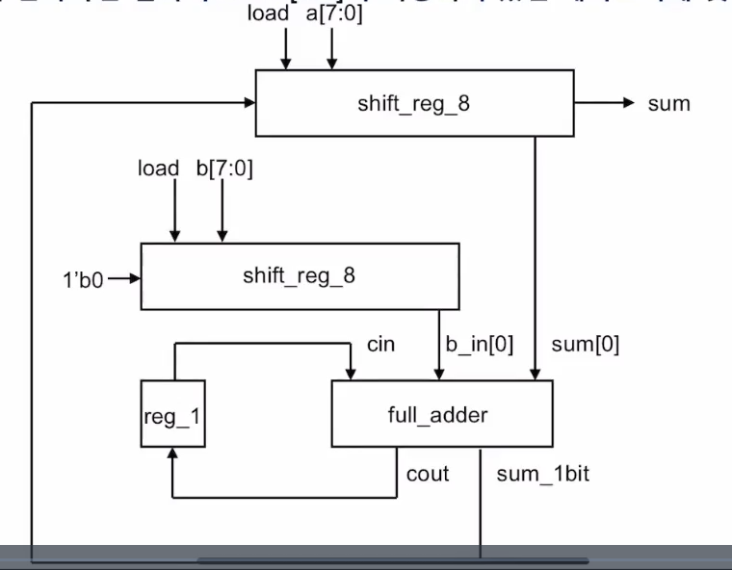

Slide 23
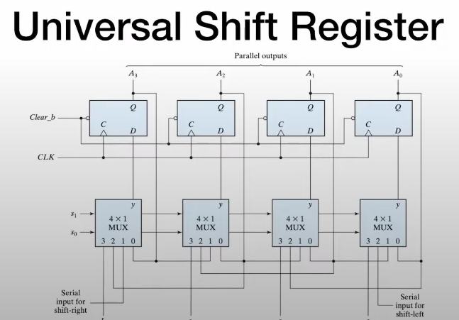
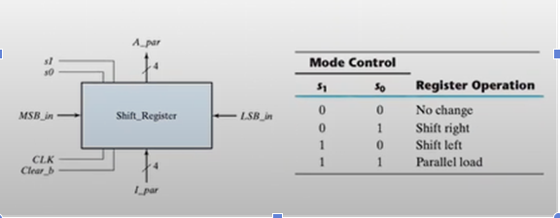

Slide 24
module universal_register
#(parameter N= 4) (
input clk. reset_n, input [N-1:0] I, input [1:0] s,
output [N-1:0] Q );
reg [N-1:0] Q_reg, Q_next ;
always@(posedge clk, negedge reset_n)
begin
if(!reset_n)
Q_reg <= 1’b0 ;
else
Q_reg <= Q_next ;
end
always@(Q_reg, MSB_in, LSB_in, I) begin
Q_next = Q_reg ;
case(s)
2’b00: Q_next = Q_reg ;
2’b01: Q_next = {MSB_in, Q_reg[N-1:0]} ;
2’b10: Q_next = {Q_reg[N-1:0], LSB_in } ;
2’b11: Q_next =I;
default : Q_next = Q_reg ;
endcase
end
assign Q = Q_reg ;
endmodule

Slide 25
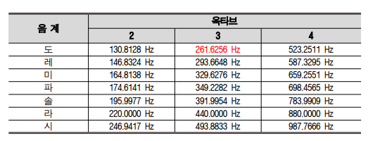
PIEZO
module HB_PIEZO( RESETN, CLK, PIEZO );
input RESETN, CLK; output PIEZO;
reg BUFF; integer CNT_SOUND;
wire PIEZO;
always @(posedge RESETN or posedge CLK)
Begin
if (RESETN) begin
BUFF = 1'b0
CNT_SOUND = 0;
end
else
begin
if (CNT_SOUND >= 1910)

Slide 26
//도레미파솔라시도 출력 프로그램
module HB_PIANO (
RESETN, CLK, KEY, PIEZO );
input RESETN, CLK;
input [7:0] KEY;
output PIEZO;
reg BUFF;
reg [7:0] CNT_SOUND;
reg [7:0] LIMIT;
wire PIEZO;
always @(KEY)
begin
case (KEY)
8'b10000000 : LIMIT = 1910; // DO
8'b01000000 : LIMIT = 1701; // RAE
8'b00100000 : LIMIT = 1516; // MI
8'b00010000 : LIMIT = 1431; // FA
8'b00001000 : LIMIT = 1275; // SOL
8'b00000100 : LIMIT = 1135; // RA
8'b00000010 : LIMIT = 1011; // SI
8'b00000001 : LIMIT = 955; // High DO
default : LIMIT = 0;
endcase
end

Slide 27
always @(posedge CLK) begin
if (RESETN)
Begin
BUFF = 1'b0;
CNT_SOUND = 0;
end
Else
begin
if (CNT_SOUND >= LIMIT)
Begin
CNT_SOUND = 0;
BUFF = ~ BUFF;
end
Else
CNT_SOUND = CNT_SOUND + 1;
end
end
assign PIEZO = BUFF;
endmodule

